Slide 1

Functions

Slide 2
Recap
Functions
libraries
Static methods

Slide 3
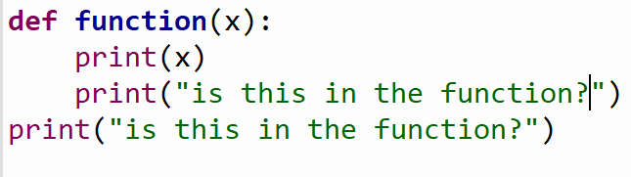
Example

Slide 4
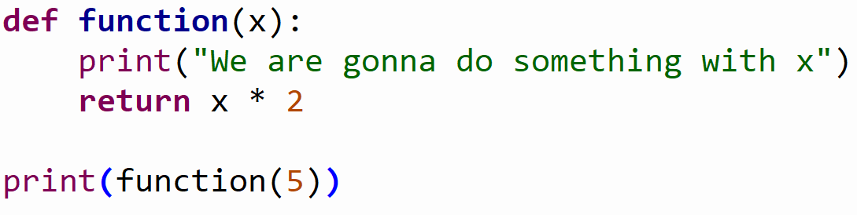
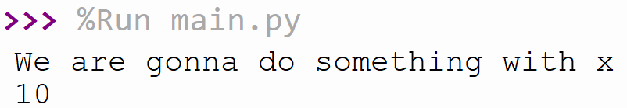
Example

Slide 5
Exercises (30 min)
Use the math library
Create a function that takes 1 parameter that will be the number given by the user.
Give power of from 1 to the number given by the user
So if the user enter the number 5 the function will print
1² = 1
2² = 4
…
--------------------------------------------------------------------------------------------------------------
Create a second function that also takes 1 parameter that will be the number given by the user
Go from 1 to the user input
At every point you add the result from the power of the number to the value.
So if the user enters 5 the returned result from the function should be
1² + 2² + 3² + 4² + 5² = …

Slide 6
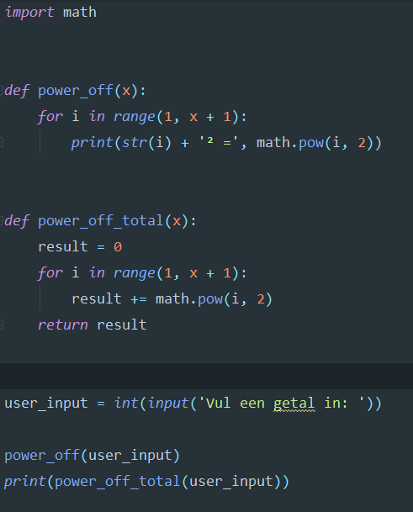
Result

Slide 7
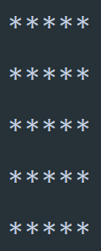
Example
How could we create a grid?

Slide 8
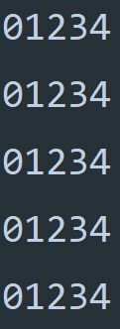
Example
What do we need to use to create this?
A user input (how big the grid should be)
A function that prints the grid
…

Slide 9
Exercise create a grid (20 min)
A user input (how big the grid should be)
A function that prints the grid
…

Slide 10
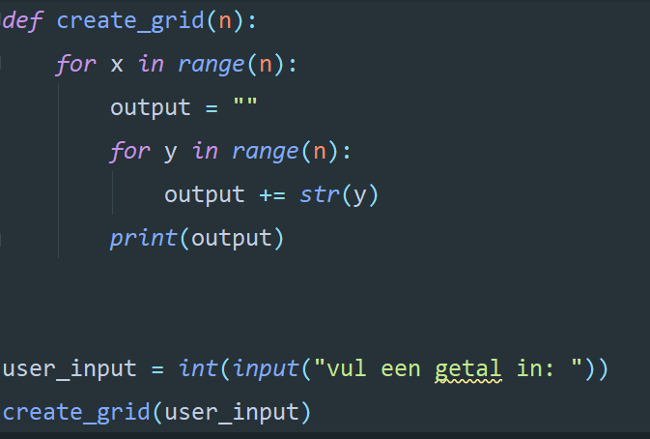
Result

Slide 11

What is unclear?

Slide 12
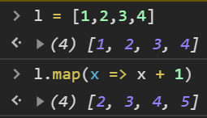
Example map
What is a Map function?
Similair to foreach
Implemented function in most languages

Slide 13
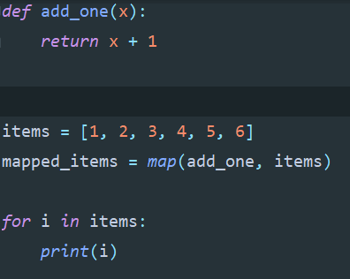
Example map
What is a Map function?
Similair to foreach
Implemented function in most languages

Slide 14
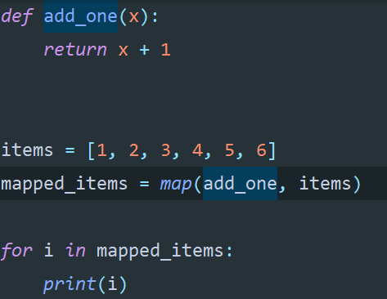
Example map

Slide 15
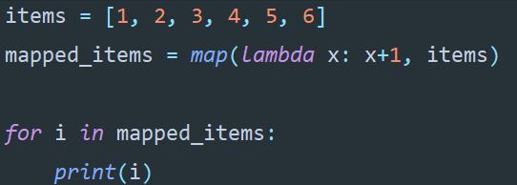
Example map

Slide 16
Summary
More about functions
How do we make a simple grid
Discussed all things that were unclear
Introduction to Map

